Slide 1

Time Complexity
Presented by:
Elizer Ponio Jr.
Department of Computer Science
College of Computing and Information Technologies

Slide 2
Outline
What is Time Complexity?
Step Count method
Examples
Time Complexity Functions
Comparison of Time Complexity Functions

Slide 3
What is an Time Complexity?
Time Complexity is the amount of time taken by the algorithm to run.
It measures the time taken to execute each statement of code in an algorithm.
The Time Complexity of an algorithm can be calculated using the Step Count Method

Slide 4
What is Time Complexity?
The step count method is one of the methods to analyze the Time complexity of an algorithm.
In this method, we count the number of times each instruction is executed. Based on that we will calculate the Time Complexity.
It is also known as the Frequency Count method

Slide 5
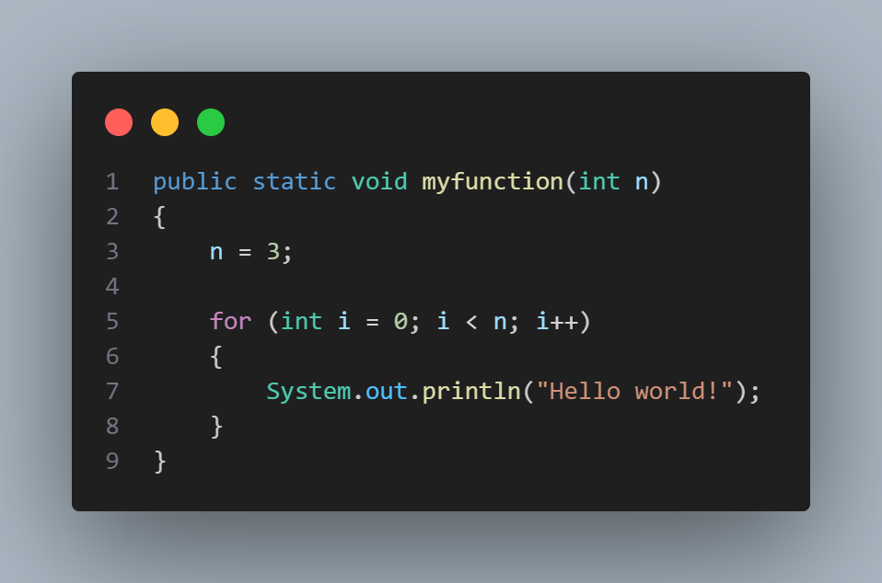




“Hello World!” will be displayed 3 times in the output
1
$$n+1$$
$$n$$
$$f\left(n\right)= 2n+2$$
$$O\left(n\right)$$

Slide 6





“Hello World!” will be displayed 3 times in the output
1
$$n+1$$
$$n$$
$$f\left(n\right)= 2n+2$$
$$O\left(n\right)$$

Slide 7
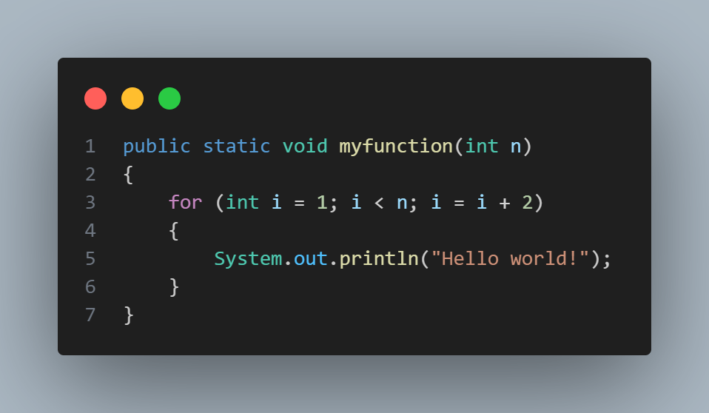


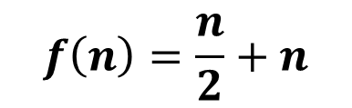
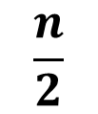
“Hello World!” will be displayed n/2 times in the output
$$\frac{n}{2}$$
$$n$$
$$f\left(n\right)=\frac{n}{2}+n$$
$$O\left(n\right)$$

Slide 8
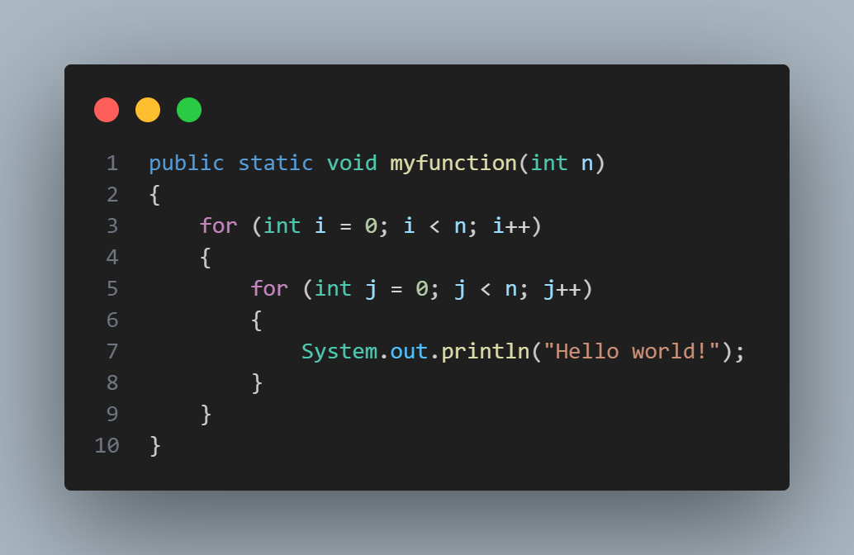




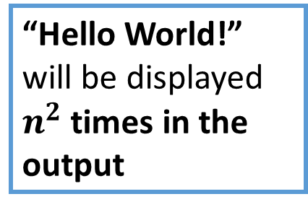

“Hello World!” will be displayed $n^{2}$ times in the output
$$n+1$$
$$n×(n+1)$$
$$n×n$$
$f\left(n\right)=n+1+n^{2}+n+n^{2}$
$$O\left(n^{2}\right)$$

Slide 9

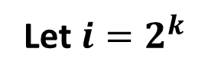
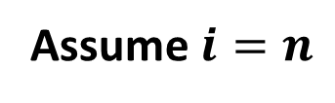
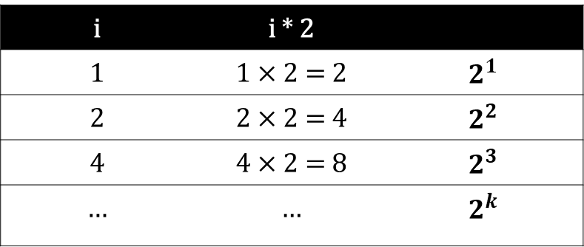



i | i * 2
1 | 1 $×$ 2 = 2 | $$2^{1}$$
2 | 2 $×$ 2 = 4 | $$2^{2}$$
4 | 4 $×$ 2 = 8 | $$2^{3}$$
… | … | $$2^{k}$$
Assume $i=n$
Let $i=2^{k}$
$$2^{k}=n$$
$$k= \log_{2}n$$
$$O\left(\log_{2}n\right)$$

Slide 10



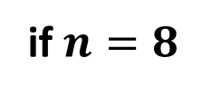
if $n=8$
$$k= \log_{2}n$$
$$k= \log_{2}8$$
$$k=3$$
“Hello World!” will be displayed 3 times in the output

Slide 11

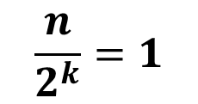
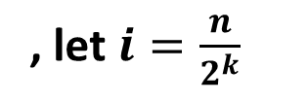
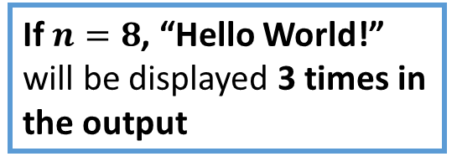
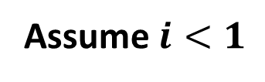

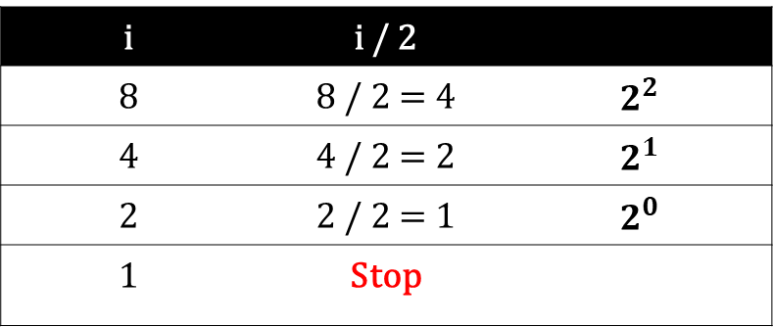


i | i / 2
8 | 8 / 2 = 4 | $$2^{2}$$
4 | 4 / 2 = 2 | $$2^{1}$$
2 | 2 / 2 = 1 | $$2^{0}$$
1 | Stop
Assume $i<1$
, let $i=\frac{n}{2^{k}}$
$$\frac{n}{2^{k}}=1$$
$$n=2^{k}$$
$$k=\log_{2}n$$
If $n=8$, “Hello World!” will be displayed 3 times in the output
$$O\left(\log_{2}n\right)$$

Slide 12





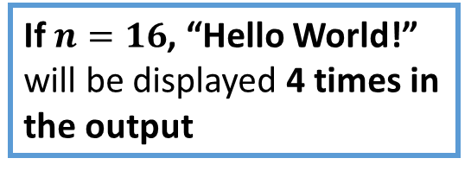
Assume $i×i≥n$
$$i^{2}=n$$
If we take the square root of both sides
$$i=\sqrt{n}$$
$$O\left(\sqrt{n}\right)$$
If $n=16$, “Hello World!” will be displayed 4 times in the output

Slide 13
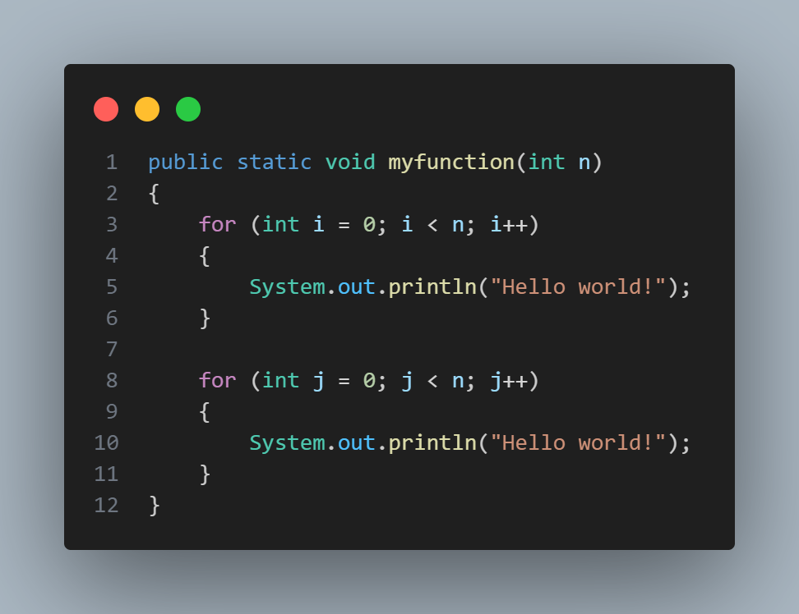


n
n
$$f\left(n\right)= 2n$$
$$O\left(n\right)$$

Slide 14
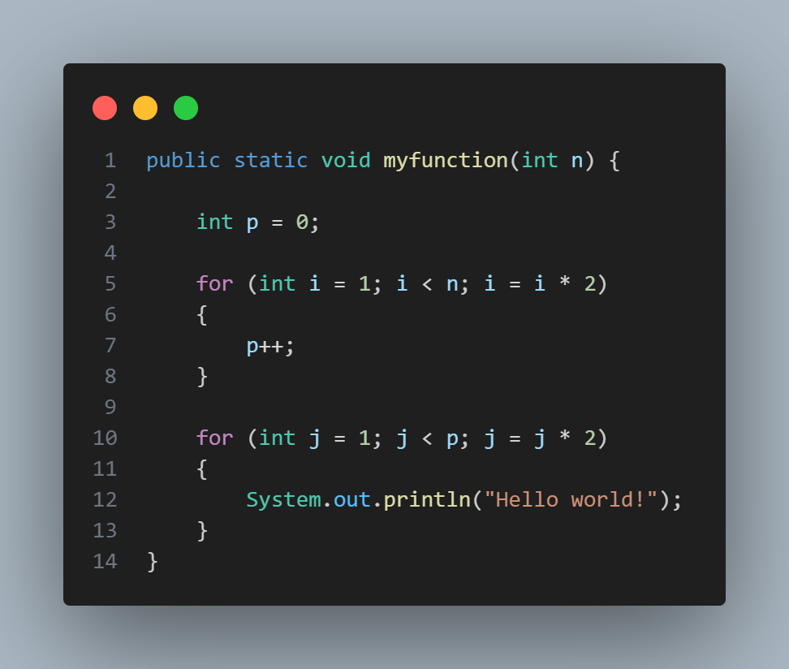



$$\log_{2}n$$
$$\log_{2}(p)$$
$$O\left({\log_{2}log}_{2}p\right)$$

Slide 15



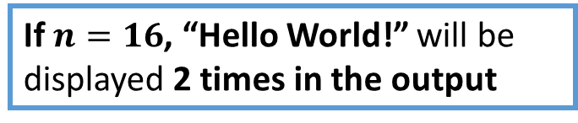


$$f\left(n\right)=\log_{2}\log_{2}p$$
$$if n=16$$
$$f\left(n\right)=\log_{2}\log_{2}16$$
$$f\left(n\right)=\log_{2}4$$
$$f(n)=2$$
If $n=16$, “Hello World!” will be displayed 2 times in the output

Slide 16
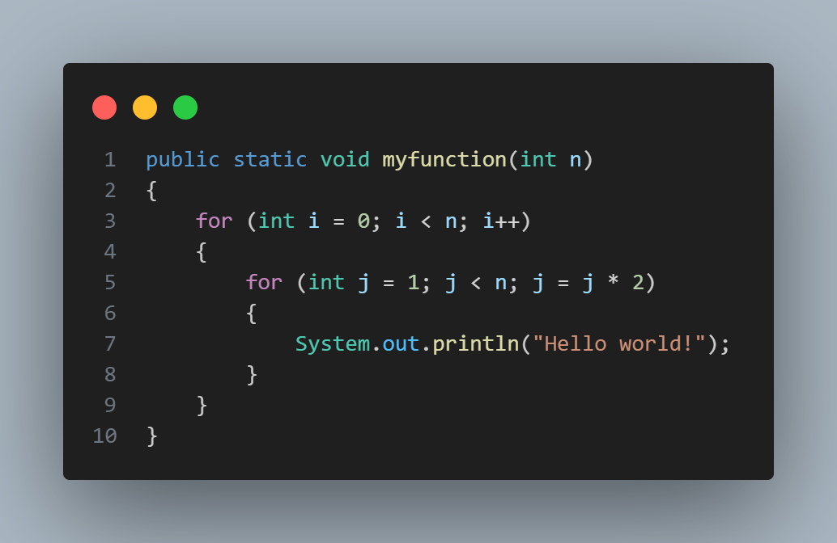





$$n$$
$${n× log}_{2}n$$
$${n× log}_{2}n$$
$$f\left(n\right)=2{n log}_{2}n+n$$
$$O\left({n log}_{2}n\right)$$

Slide 17
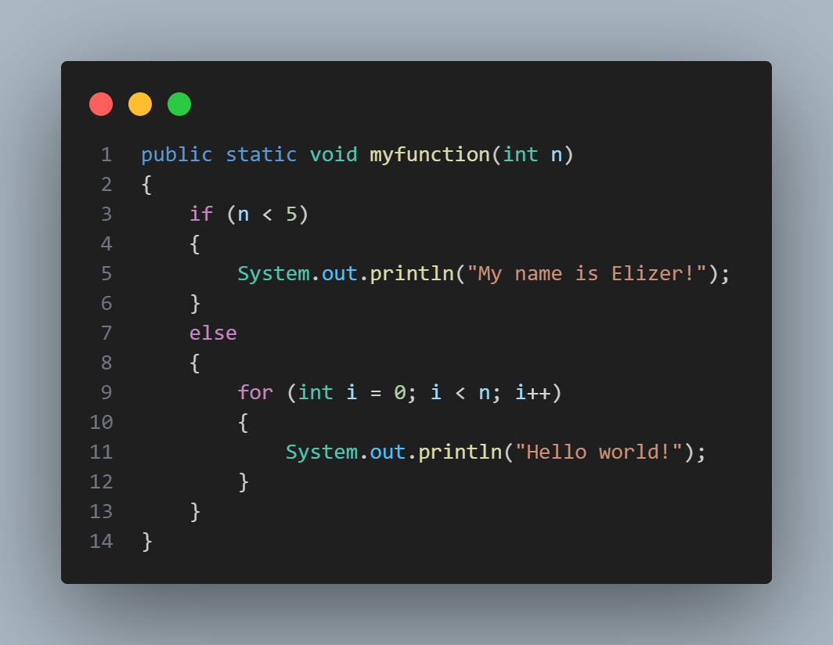




$$1$$
$$Best case=O\left(1\right)$$
$$n$$
$$Worst case=O\left(n\right)$$

Slide 18
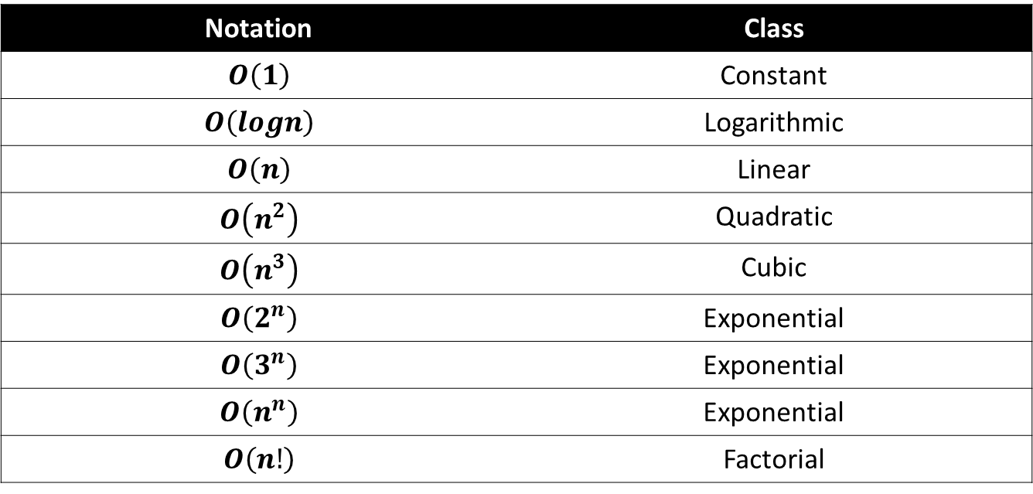
Time Complexity Functions
Notation | Class
$$O\left(1\right)$$ | Constant
$$O\left(logn\right)$$ | Logarithmic
$$O\left(n\right)$$ | Linear
$$O\left(n^{2}\right)$$ | Quadratic
$$O\left(n^{3}\right)$$ | Cubic
$$O\left(2^{n}\right)$$ | Exponential
$$O\left(3^{n}\right)$$ | Exponential
$$O\left(n^{n}\right)$$ | Exponential
$$O\left(n!\right)$$ | Factorial

Slide 19
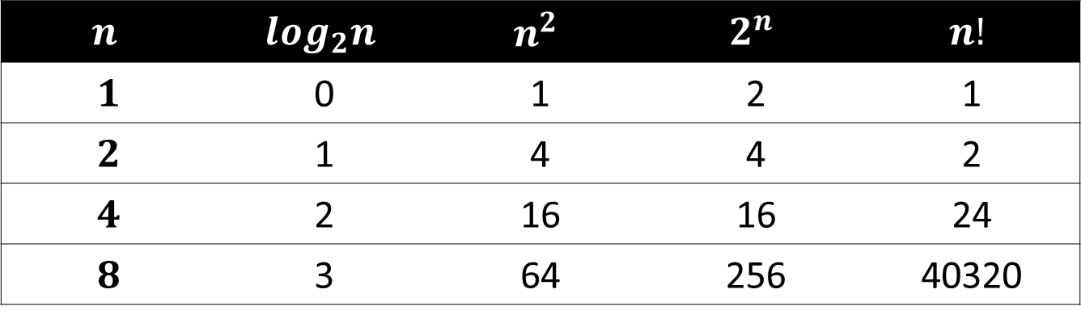
Comparison of Time Complexity Functions
$$n$$ | $$\log_{2}n$$ | $$n^{2}$$ | $$2^{n}$$ | $$n!$$
$$1$$ | 0 | 1 | 2 | 1
$$2$$ | 1 | 4 | 4 | 2
$$4$$ | 2 | 16 | 16 | 24
$$8$$ | 3 | 64 | 256 | 40320
$$1<\log_{2}n< \sqrt{n}<n<n \log_{2}n< n^{2}<n^{3}…<2^{n}< 3^{n}< …<n!$$

